Slide 1
PhD Meeting
27th September 2019

Slide 2
PhD Meeting
27th September 2019
Guilherme

Slide 3
A Comparison of Genomic Selection Models in a Hybrid Breeding Program
The objective of this study is to build a hybrid maize simulation and test different genomic selection (GS) models for their impact on selection accuracy and long-term genetic gain.

Slide 4
Genomic Selection Models
GCA Model
Inbred data;
”Small” dataset;
Easy to fit the model;
Specific to the population;
Estimate statistical effects.
Hybrid Models
Hybrid data;
Different models;
More data available;
More complex models;

Slide 5
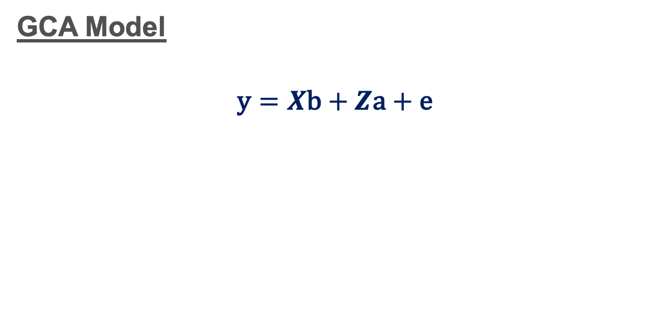
Genomic Selection Models

Slide 6
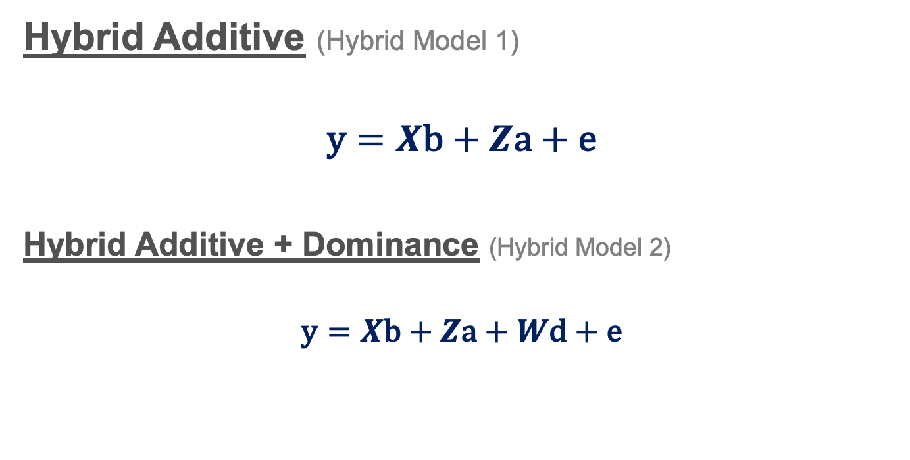
Genomic Selection Models

Slide 7
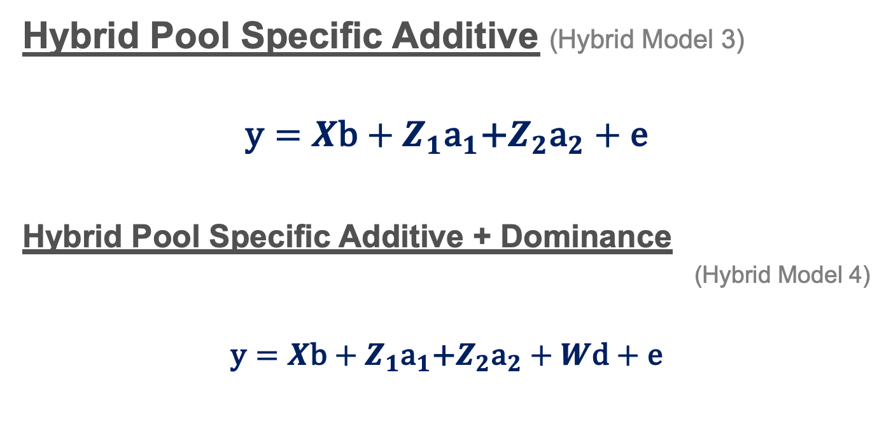
Genomic Selection Models

Slide 8
Breeding Programs
In simulations it is possible to fit different models in different hybrid breeding programs;
Simulation scenarios:
Breeding Program
Baseline
DH Rapid Cycle
Outbred Rapid Cycle
GS Models
GCA Model
Hybrid Model 1
Hybrid Model 2
Hybrid Model 3
Hybrid Model 4
Marker Density
5K
10
20K

Slide 9
PhD Meeting
27th September 2019
Owen

Slide 10
Last Week(s)
Cattle Paper
Issues collecting the results
Loop to go through different scenario folders
Estimate BV based on AlphaBayes Marker Estimates
Corr(EBV,TBV)
Store; Acc, Bias, Sim Parameters in R dataframe
Memory Intensive & Very Slow for 16k+ scenarios
Some ran on WWnodes
Others crashed – most likely due to other user jobs
runtime>48hrs -> long queues with qsub
Break AccCalc into smaller jobs -> build data back together
SnakeMake of Cattle Sim Pipeline
TP Maize
Paper with John

Slide 11
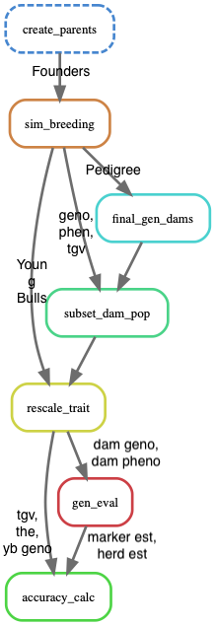
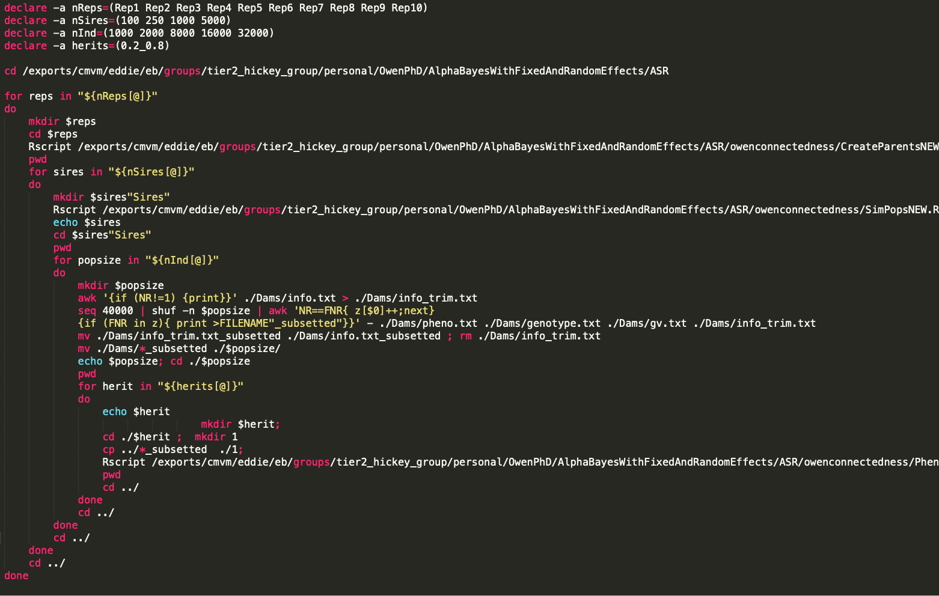
Bash -> Snakemake

Slide 12
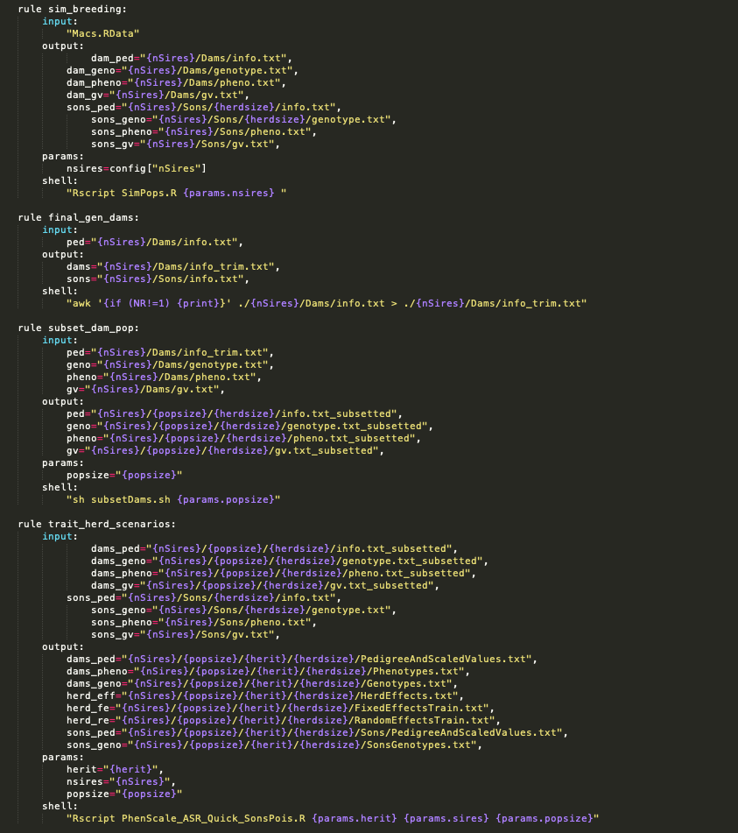
Bash -> Snakemake

Slide 13
Scenarios
Effective Population Size
1000
Relationship Matrix
GBLUP
PBLUP
Sires Per Generation
100
250
1000
5000
Population Size
2000
8000
16000
32000
Heritability
0.1
0.3
0.5
HerdSizes
Model
Animal
Random
Fixed
Notes:
Comparison of 5 generation of Pedigree (PBLUP) vs Final Generation (8k) Genotyped Cows
<number>

Slide 14
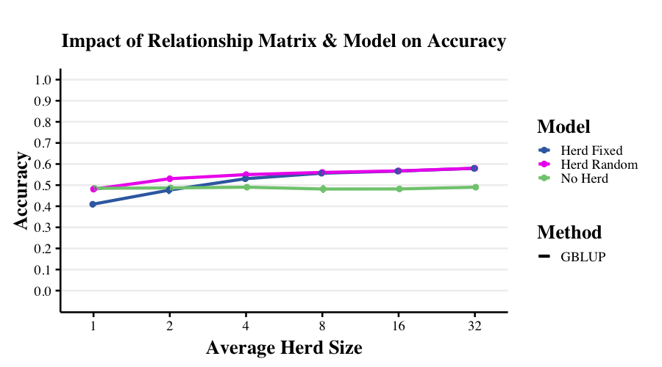

Slide 15
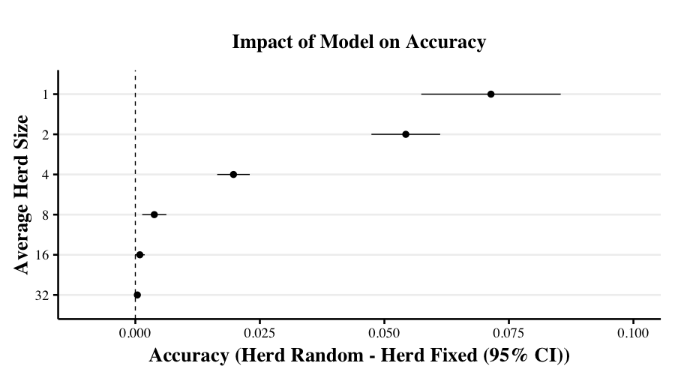

Slide 16
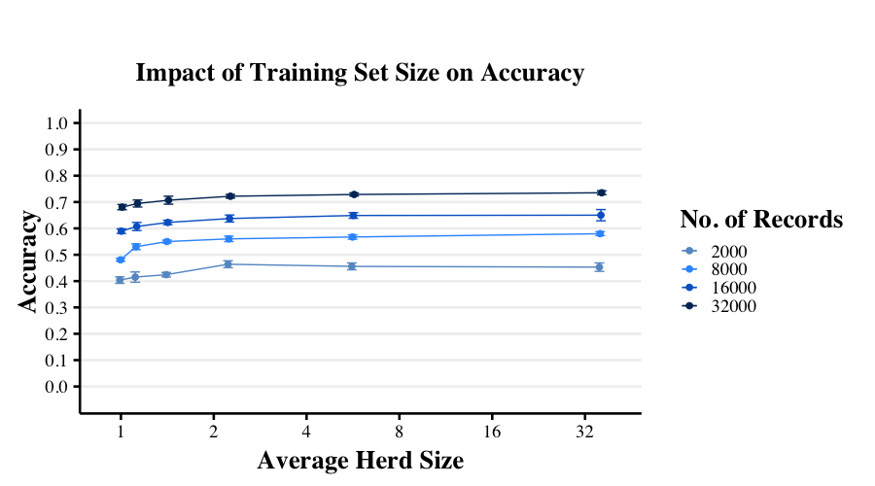
Notes:
16k & 32k (6 Reps)
<number>

Slide 17
Next Week(s)
Cattle Paper
Finish Data Collection
Different Connectedness & Variance Ratio Scen (16k+ Datasets)
Accuracy across Realized HerdSizes
Updates Values in Paper
TP Maize
Wait for comments
Think about 3rd paper….

Slide 18
PhD Meeting
27th September 2019
Luciano

Slide 19
Previous
Finish
Paper (with Andrew)
Thesis (Version 1)
Post-doc project

Slide 20
AlphaFamImpute
SNP array – 5.000
LD array – 3, 5, 10, 20, 50, 100, 200, 400
High density progeny - 1 to 150
Focal individuals – 1.000
Notes:
<number>

Slide 21
AlphaFamImpute
P₁
P₂
Phase
Imputation
HD 1
HD 2
HD 3
LD 1
LD 2
LD 3
…
LD n

Slide 22
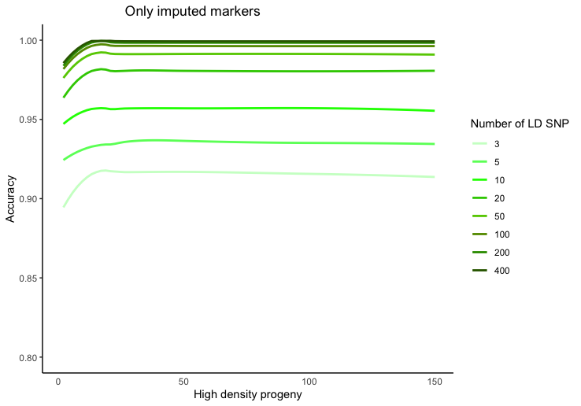
AlphaFamImpute Parents and Progeny in HD

Slide 23
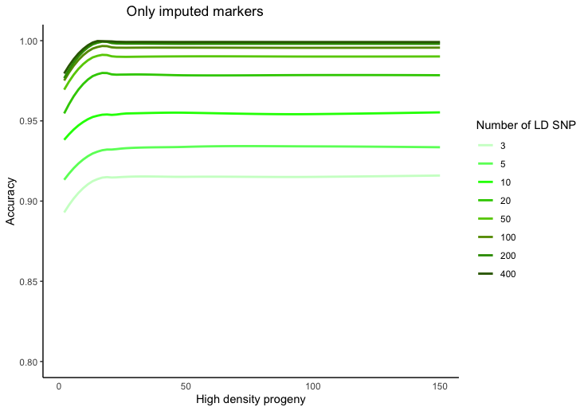
AlphaFamImpute Genotyping error ~1%

Slide 24
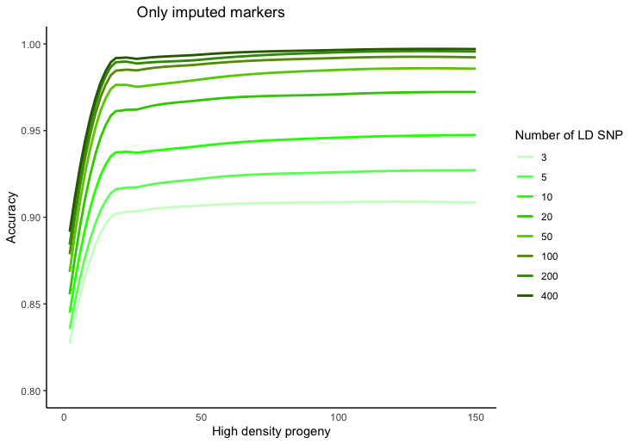
AlphaFamImpute Parents Missing

Slide 25
Next
Start Maize project
Prepare the report
Correct some error on the texts

Slide 26
PhD Meeting
27th September 2019
Troy

Slide 27
Generation Proxy Selection Mapping
Generation Proxy Selection Mapping
Idea: Fit some “generation proxy” in GWAS model to map ongoing selection within a population
Simulations: Validate that it works, see where strengths/limitations are
Testing:
N_{e}
Selection intensity
Genetic architectures
Notes:
<number>

Slide 28
New this week
Tracking allele frequency changes over time
Decreasing generation number
Scenarios with 5, 10, and 15 generations (from 20)
Why use a linear mixed model?
Increased number of SNPs (100K from 10K)
Do we see more traditional GWAS peaks?
Yes… but more coming soon
Notes:
<number>

Slide 29
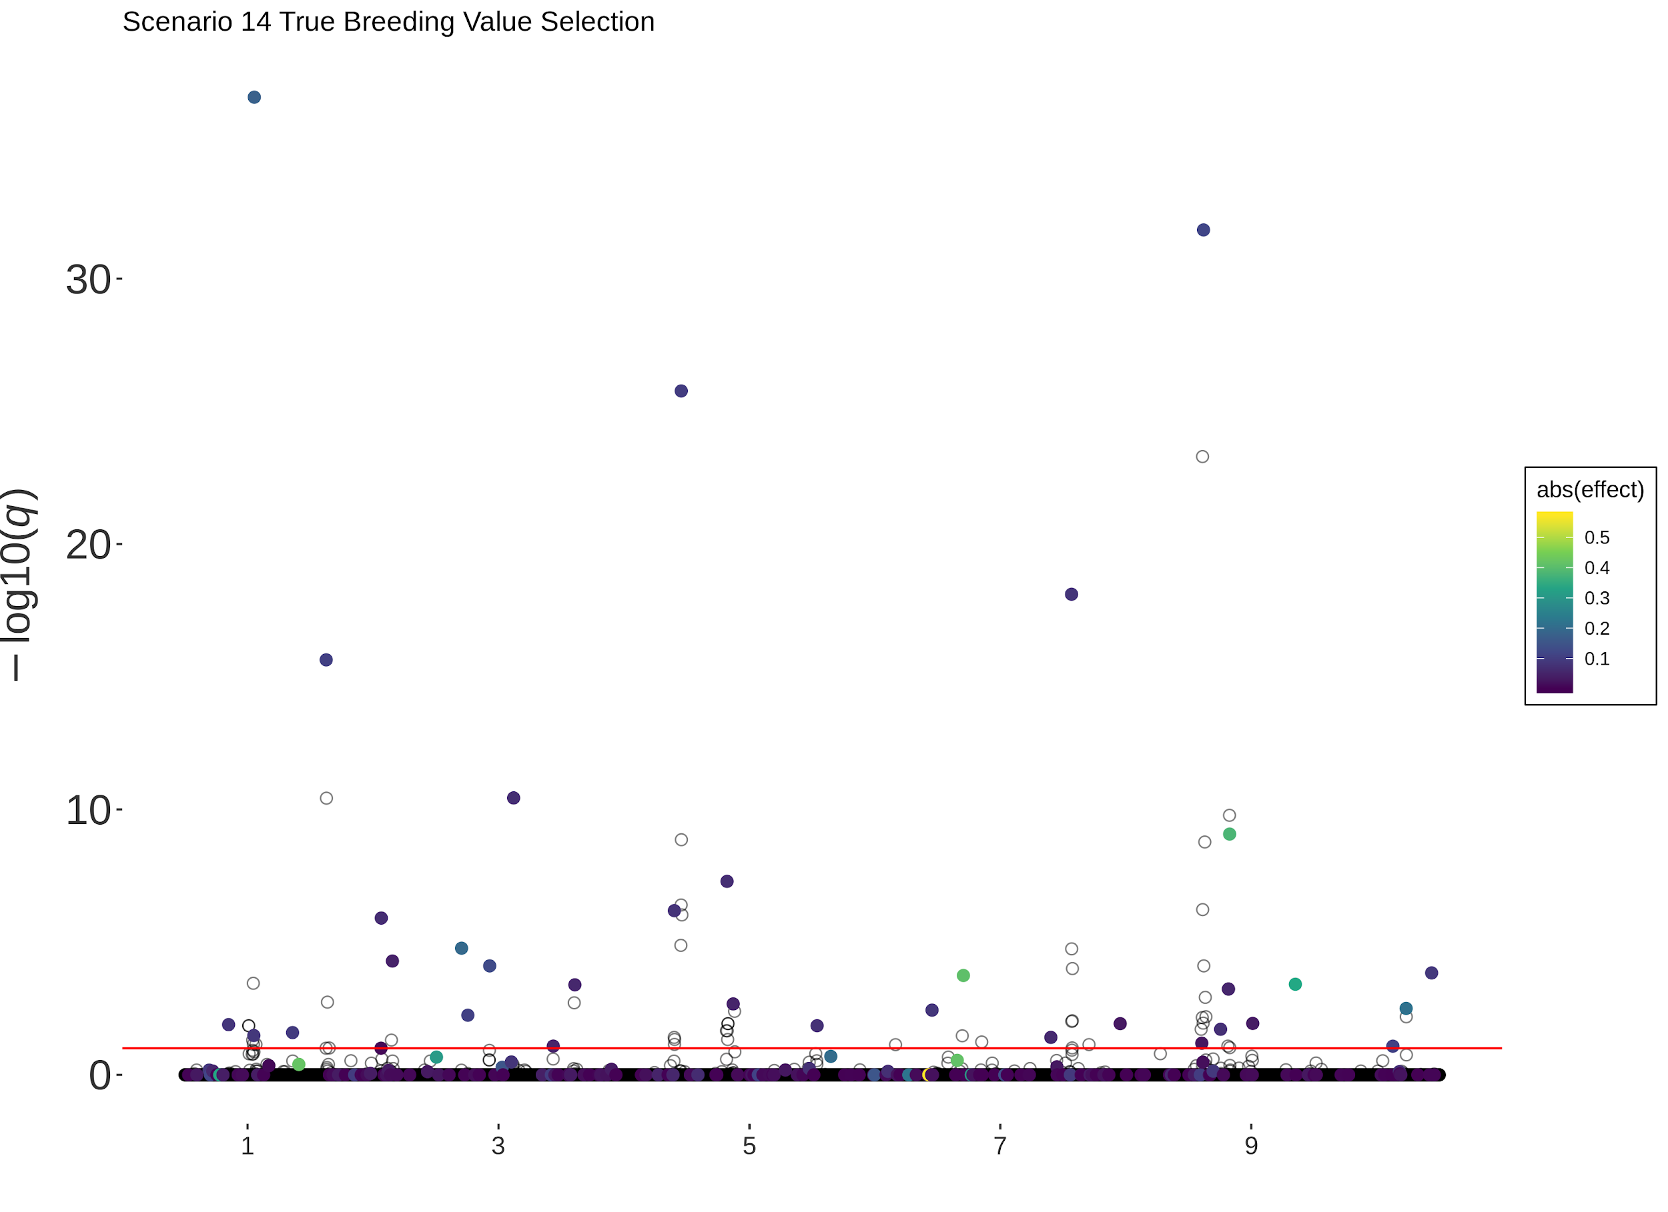
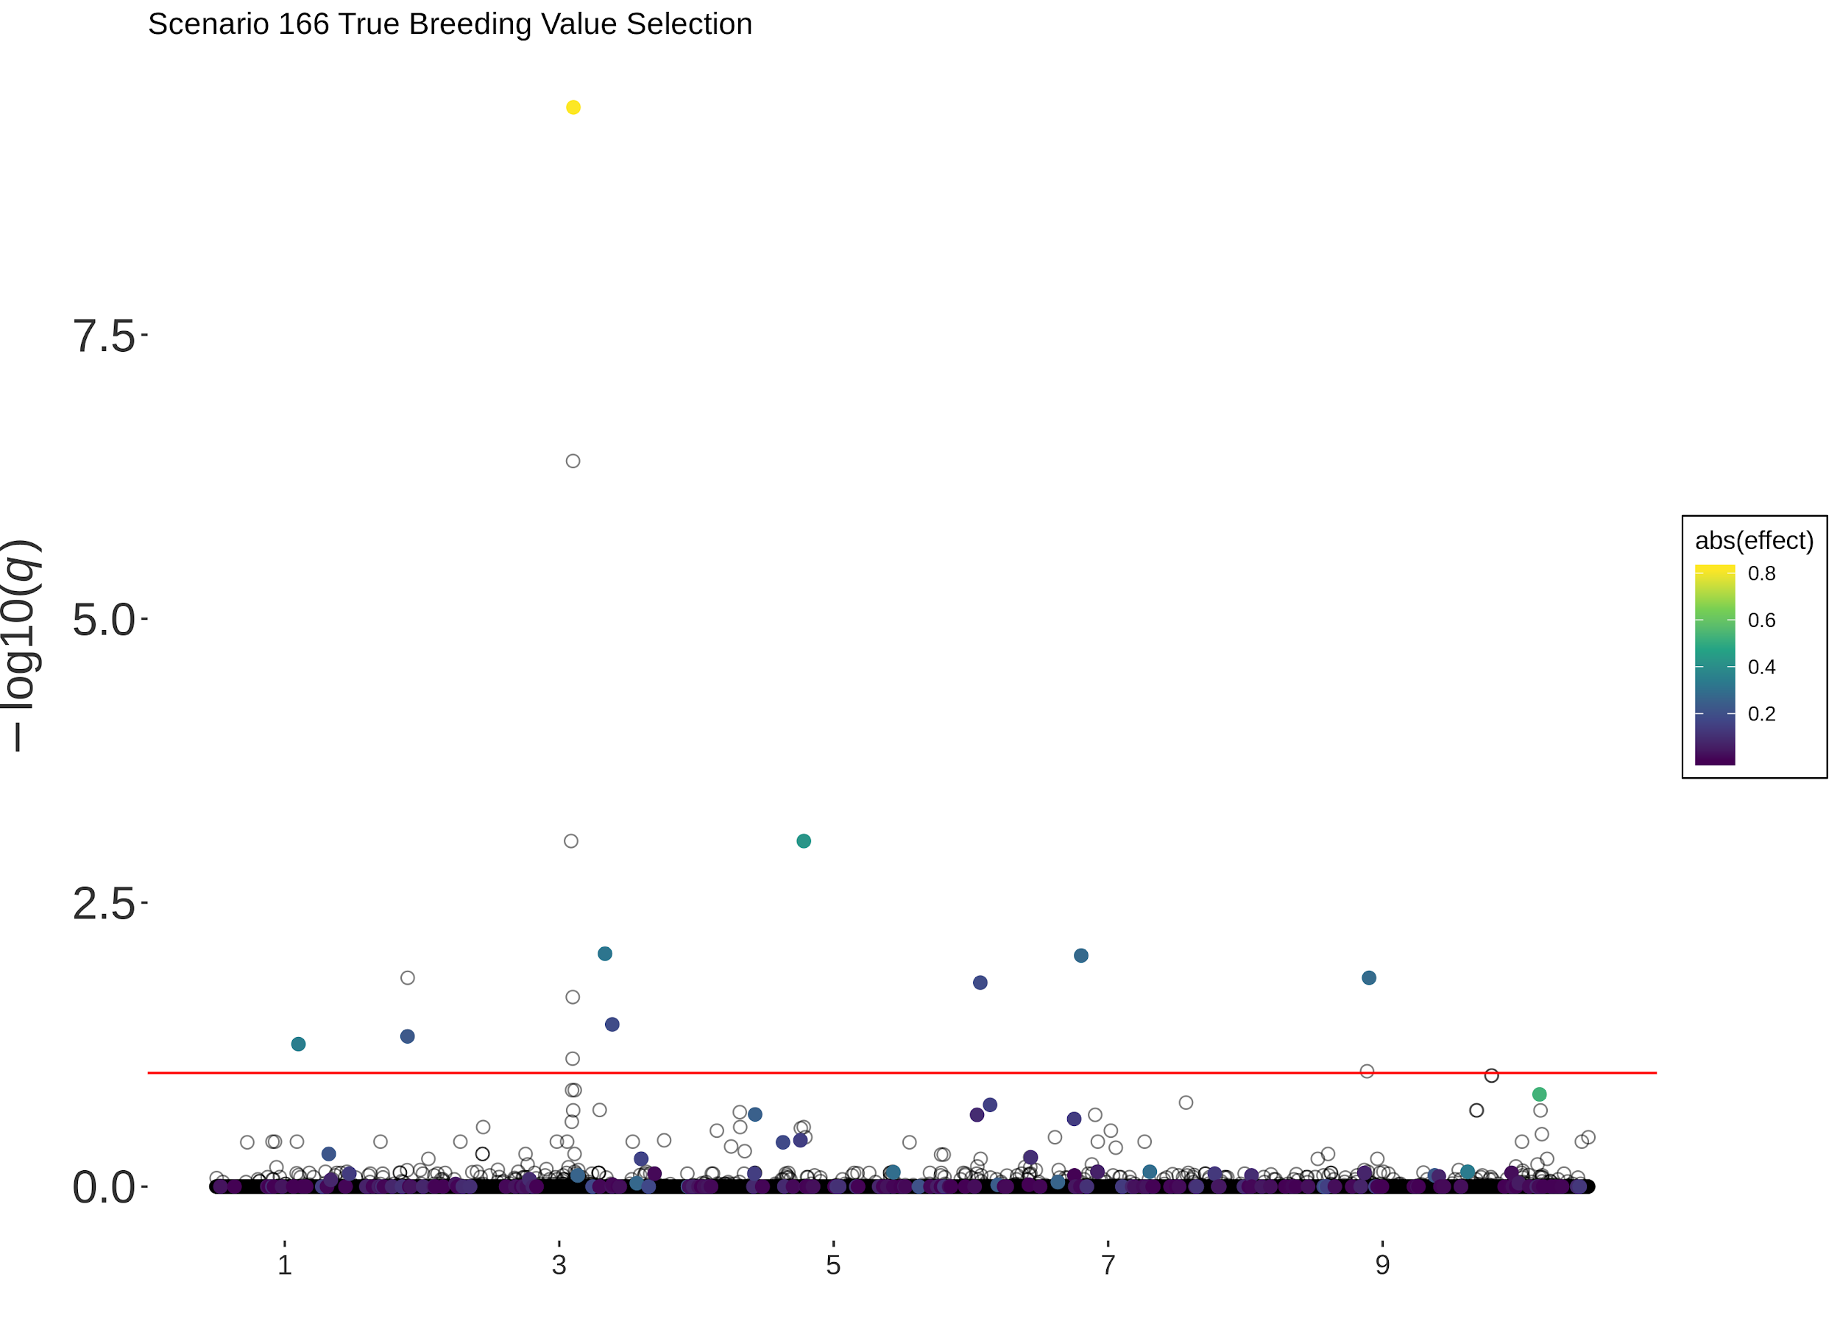
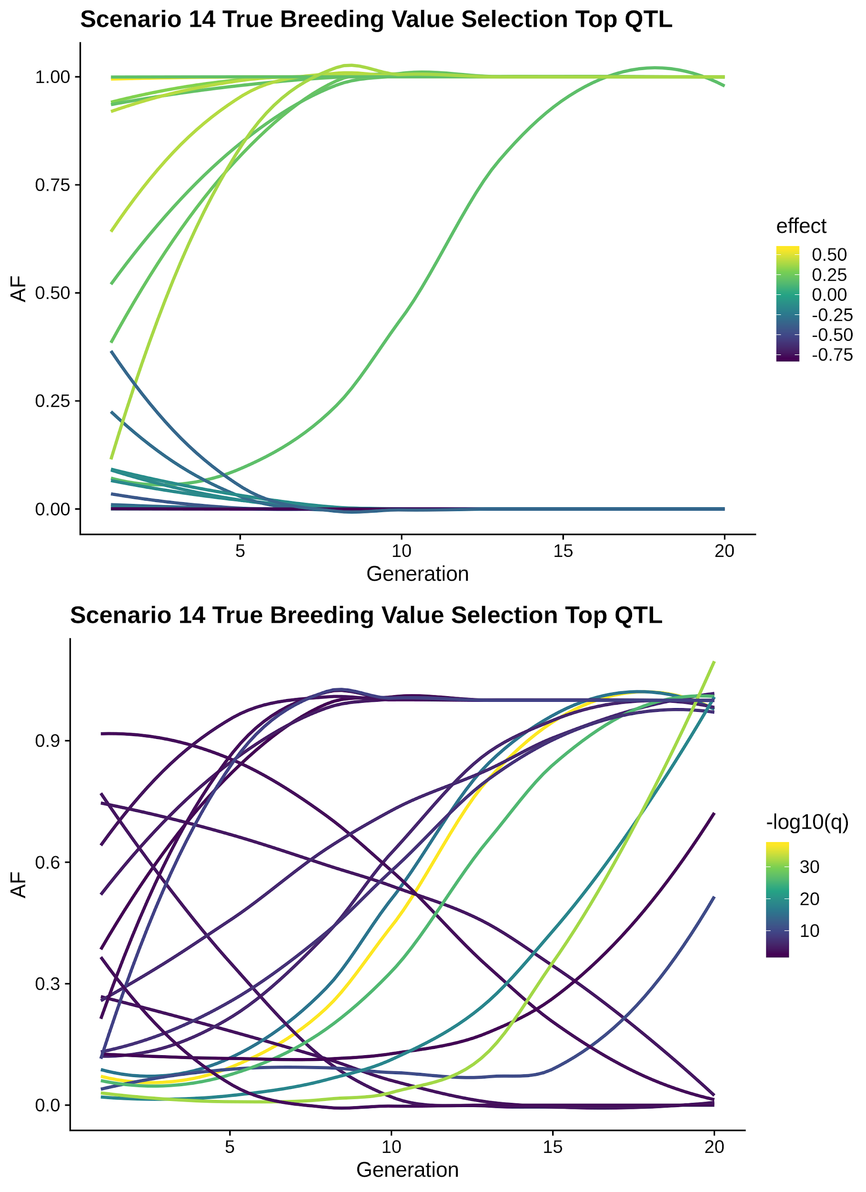
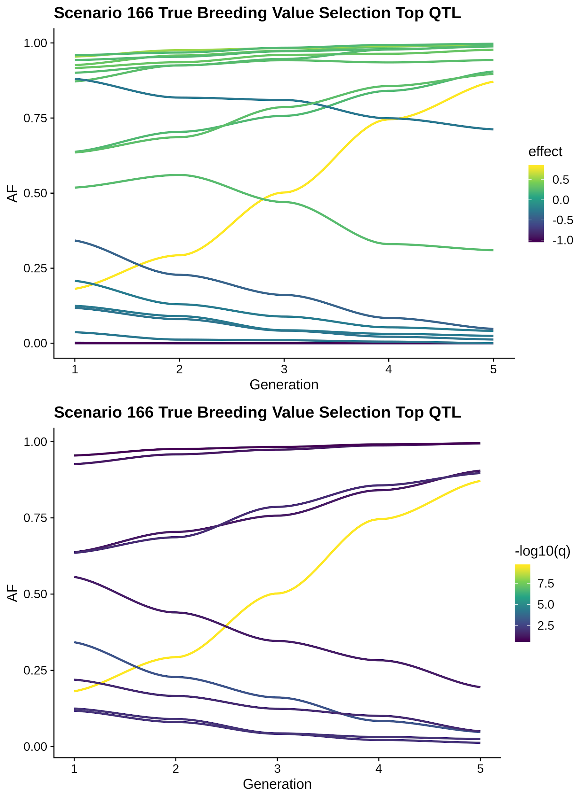
Generations of selection:
25 Generations
5 Generations
Notes:
<number>

Slide 30
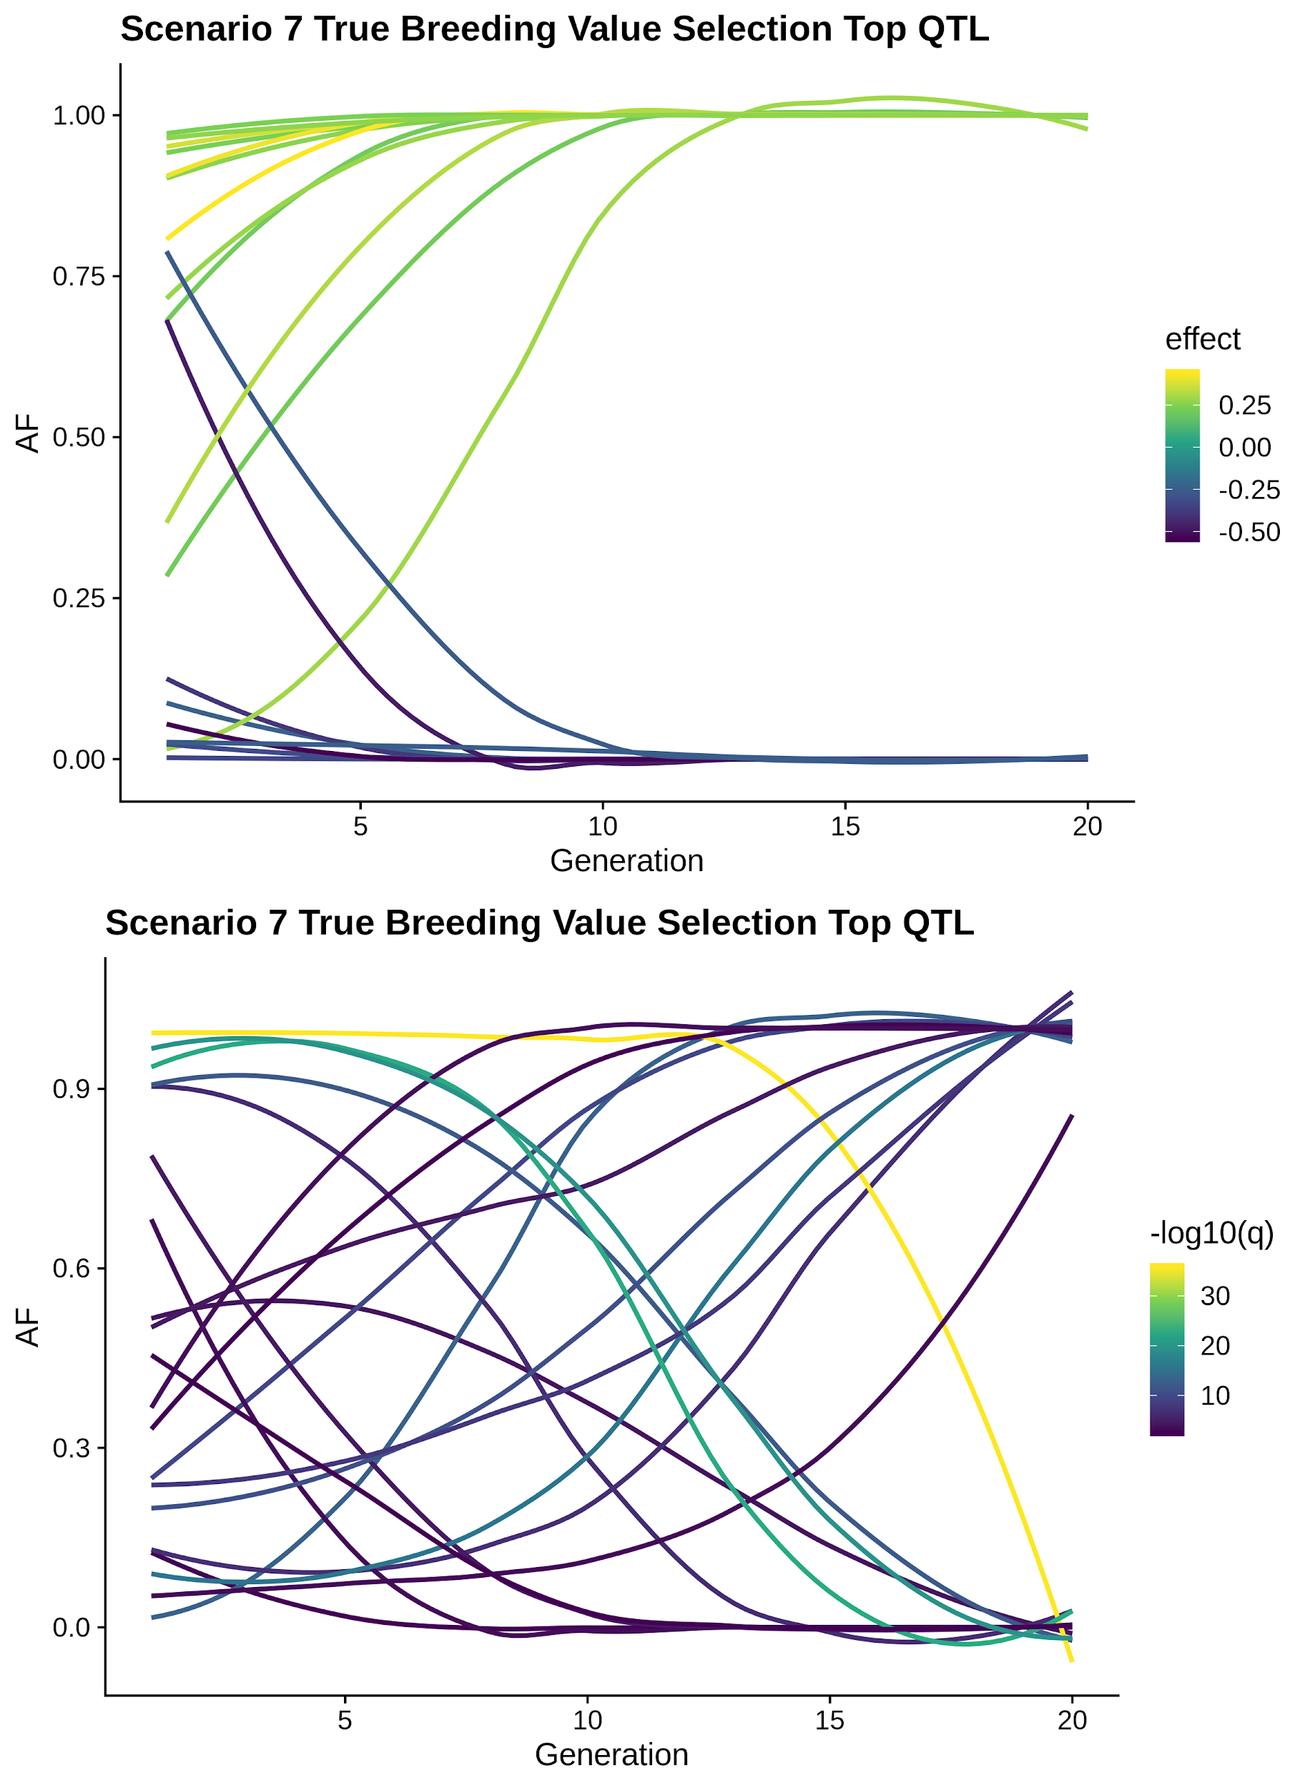
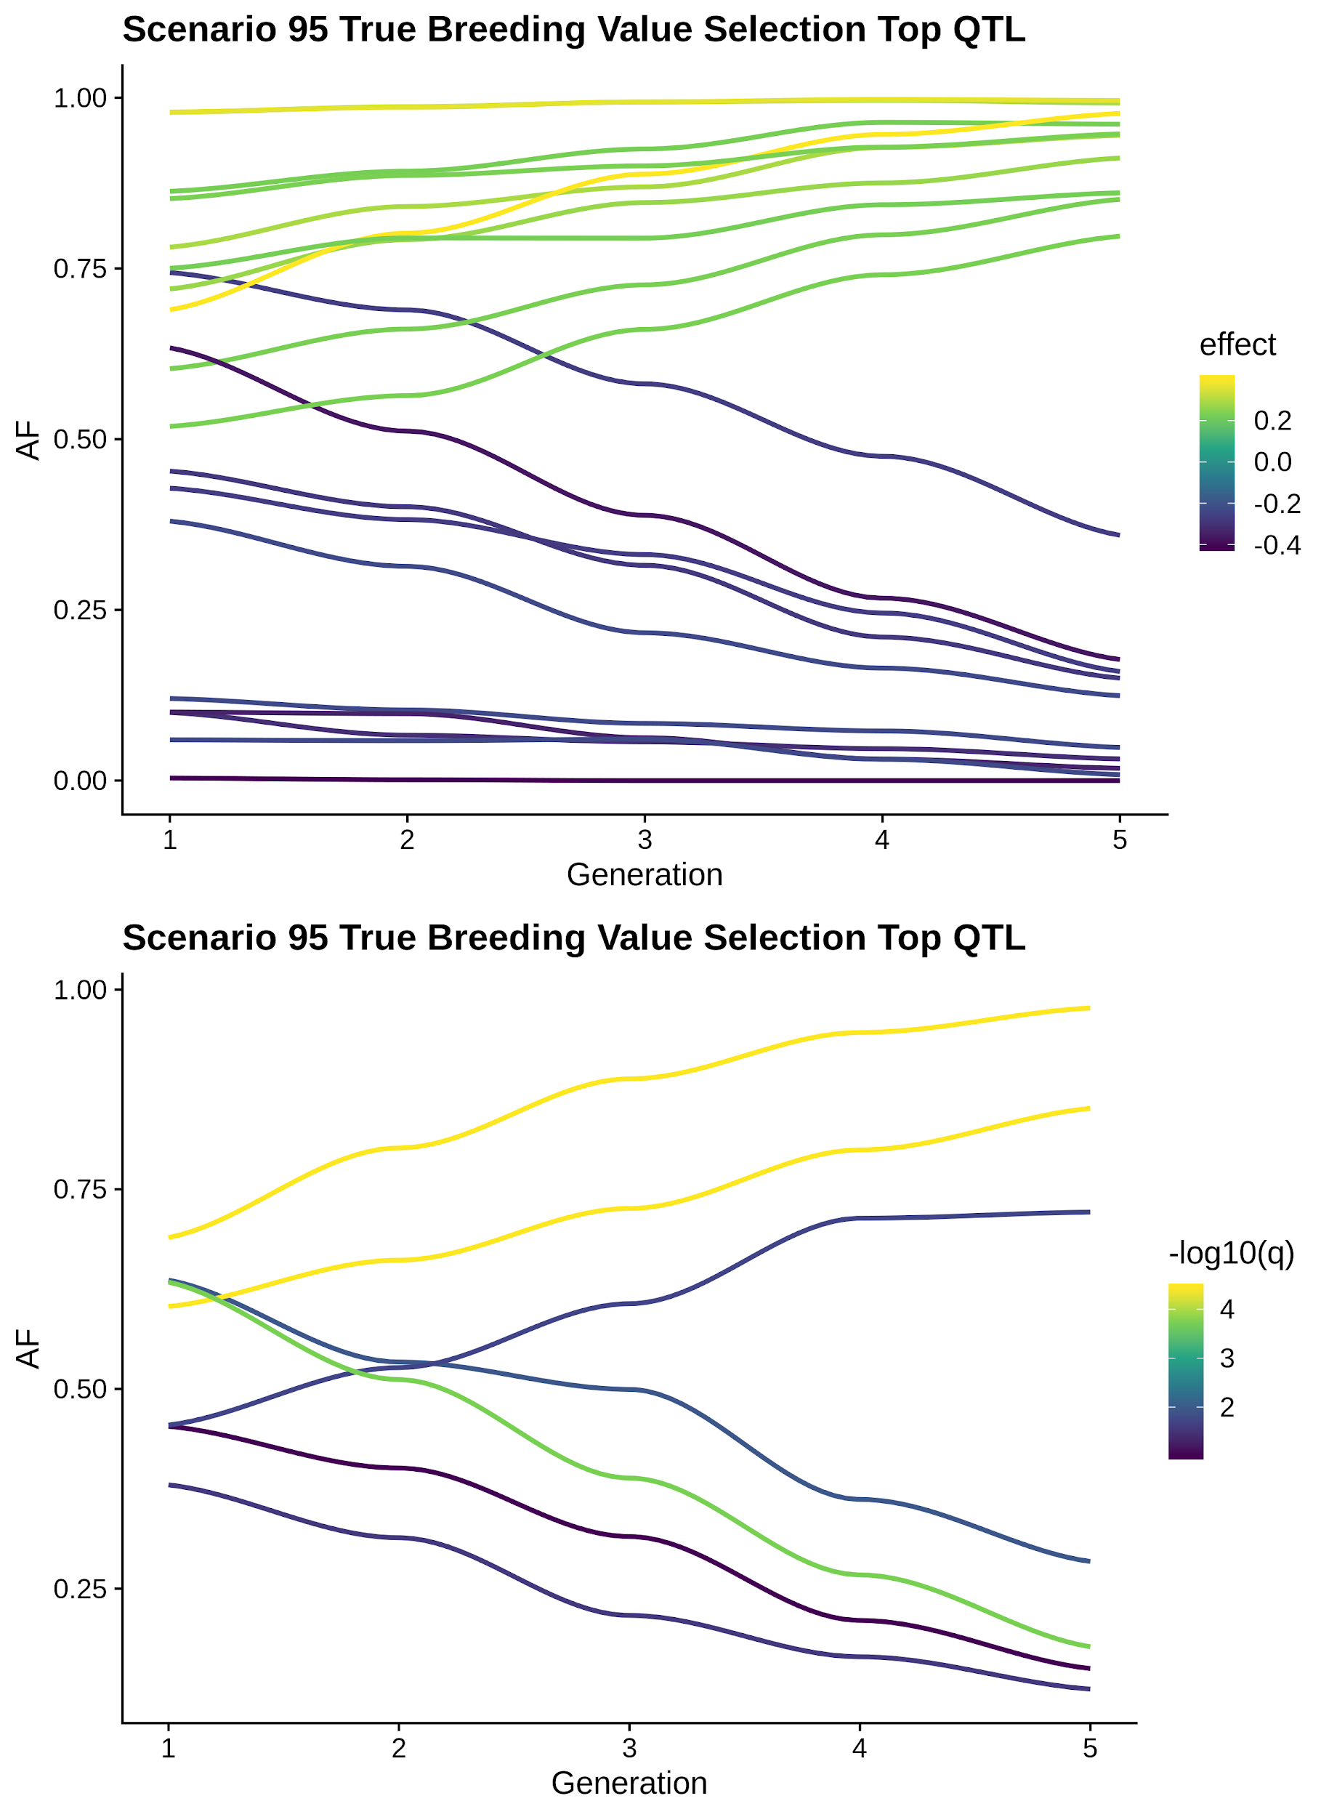
Allele frequency dynamics
Top 20 simulated QTL and top 20 GPSM hits
Notes:
<number>

Slide 31
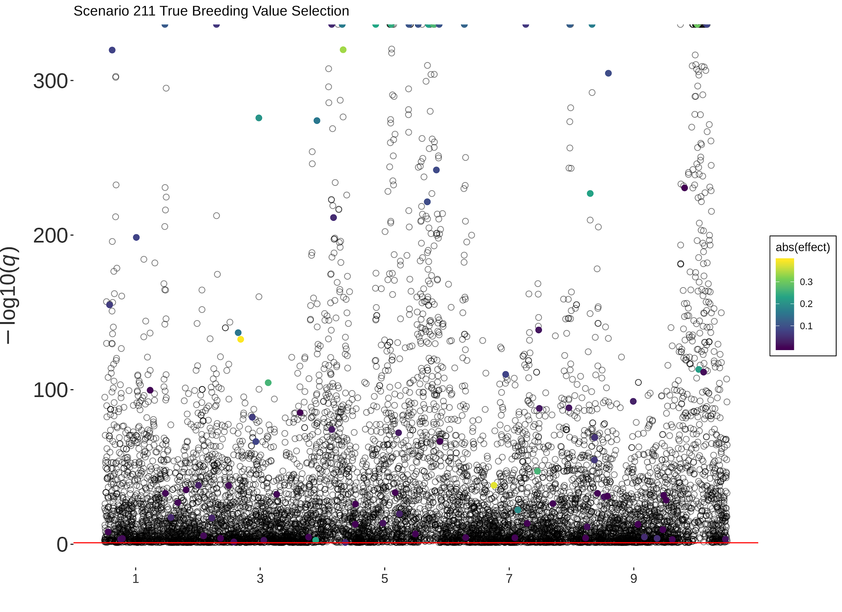
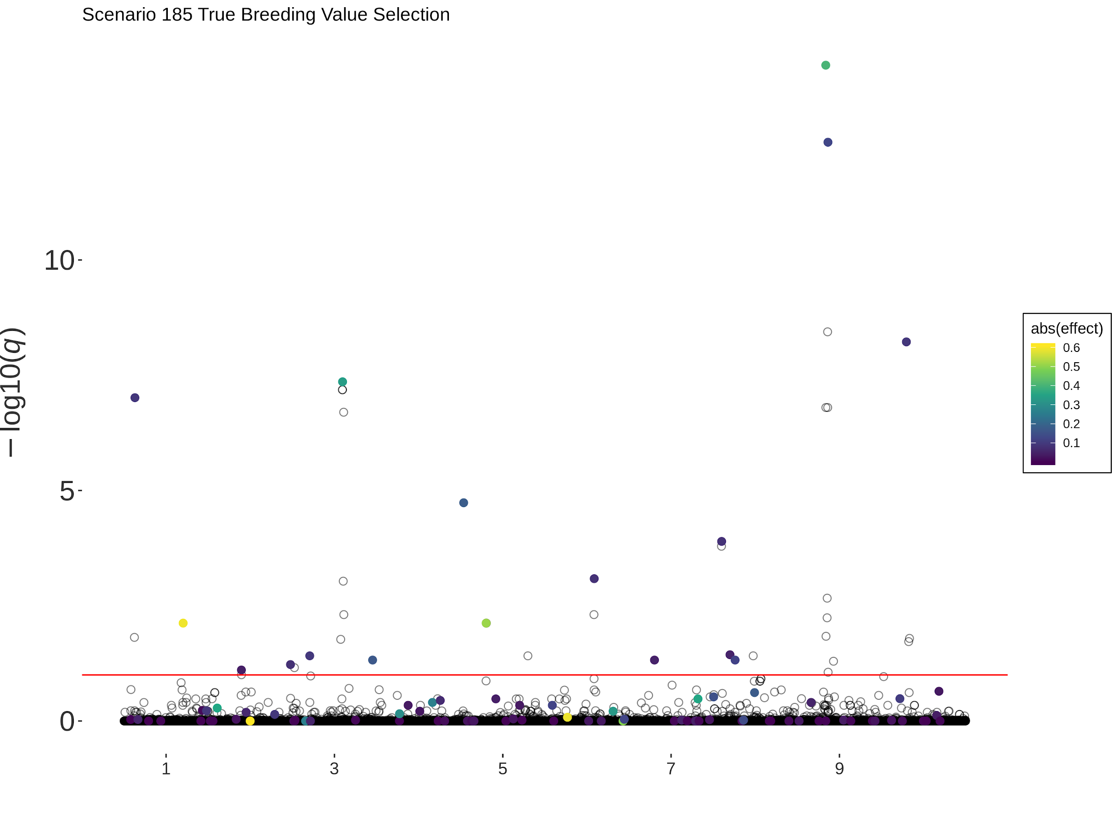
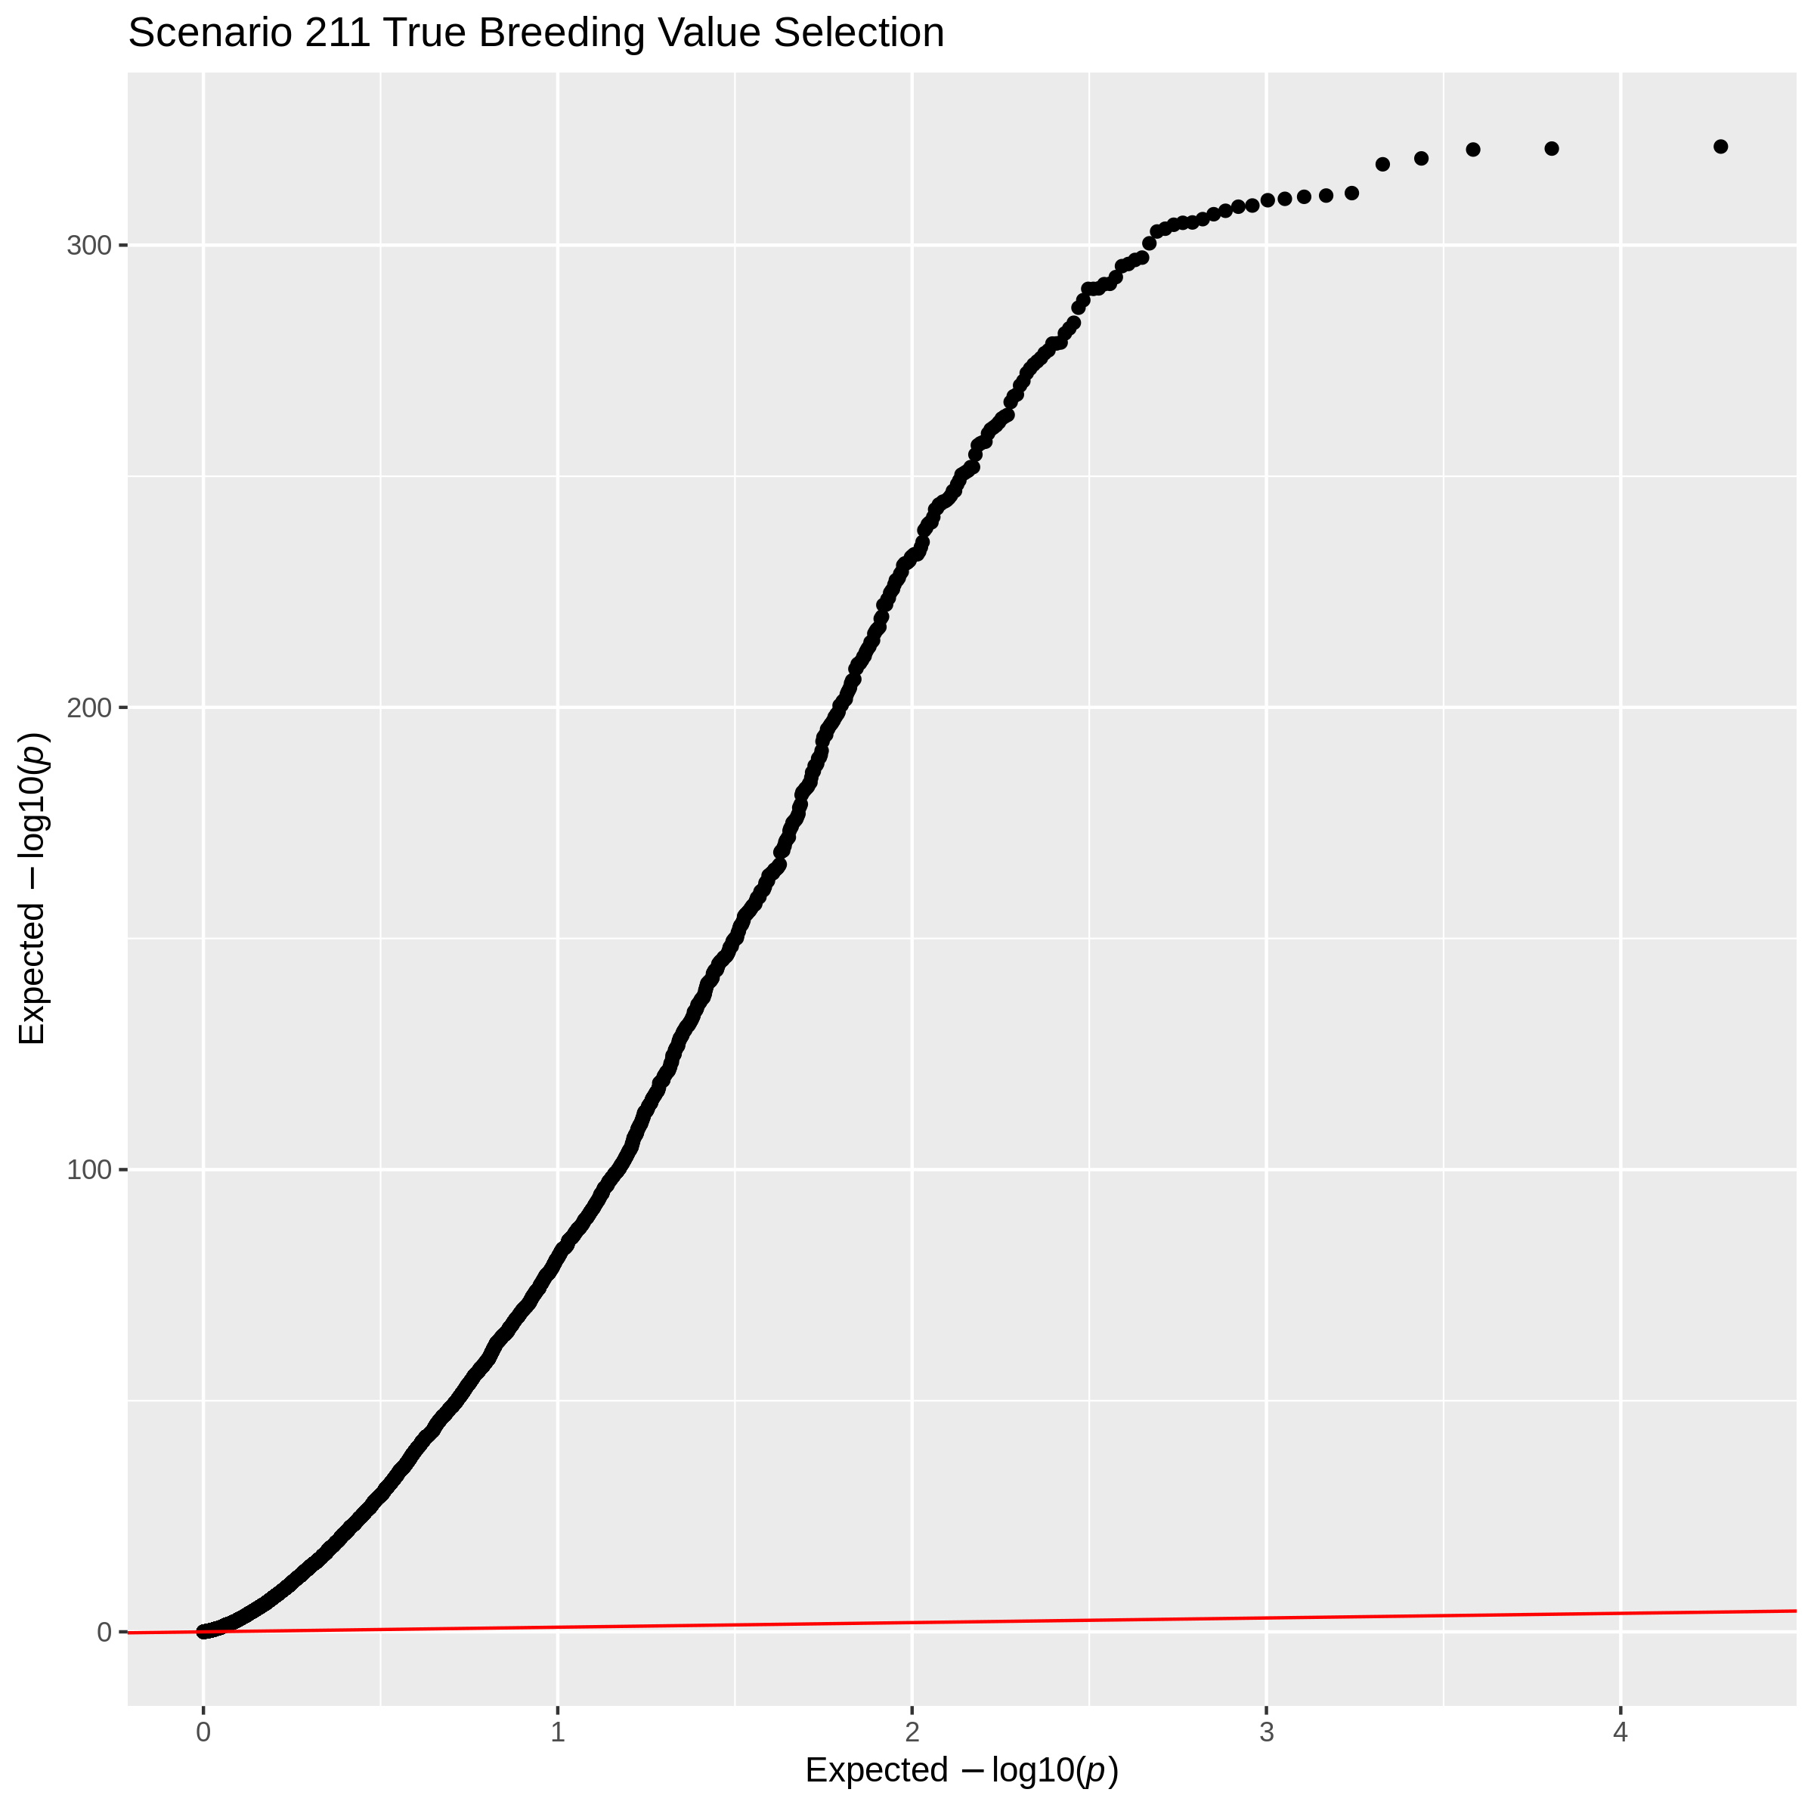
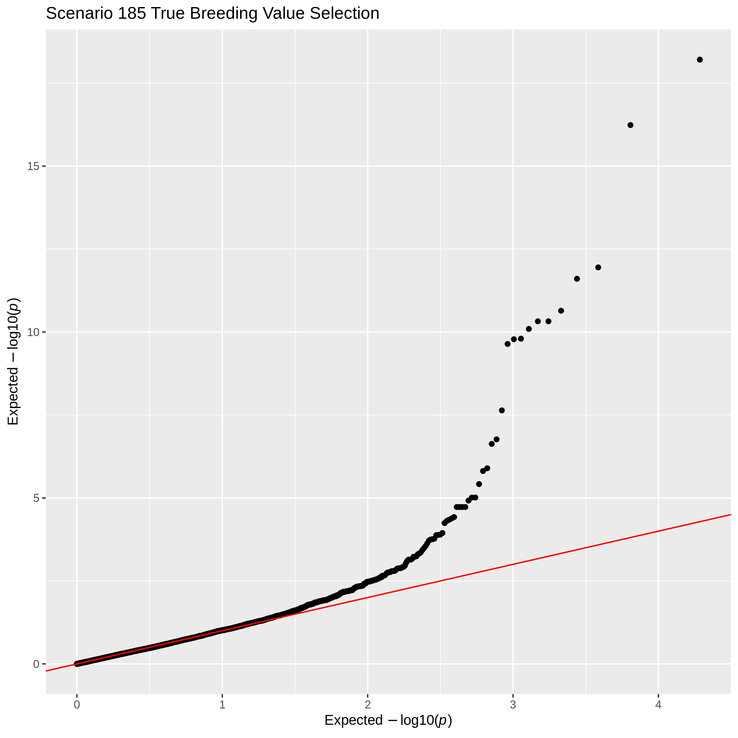
Impact of a GRM
Notes:
<number>

Slide 32
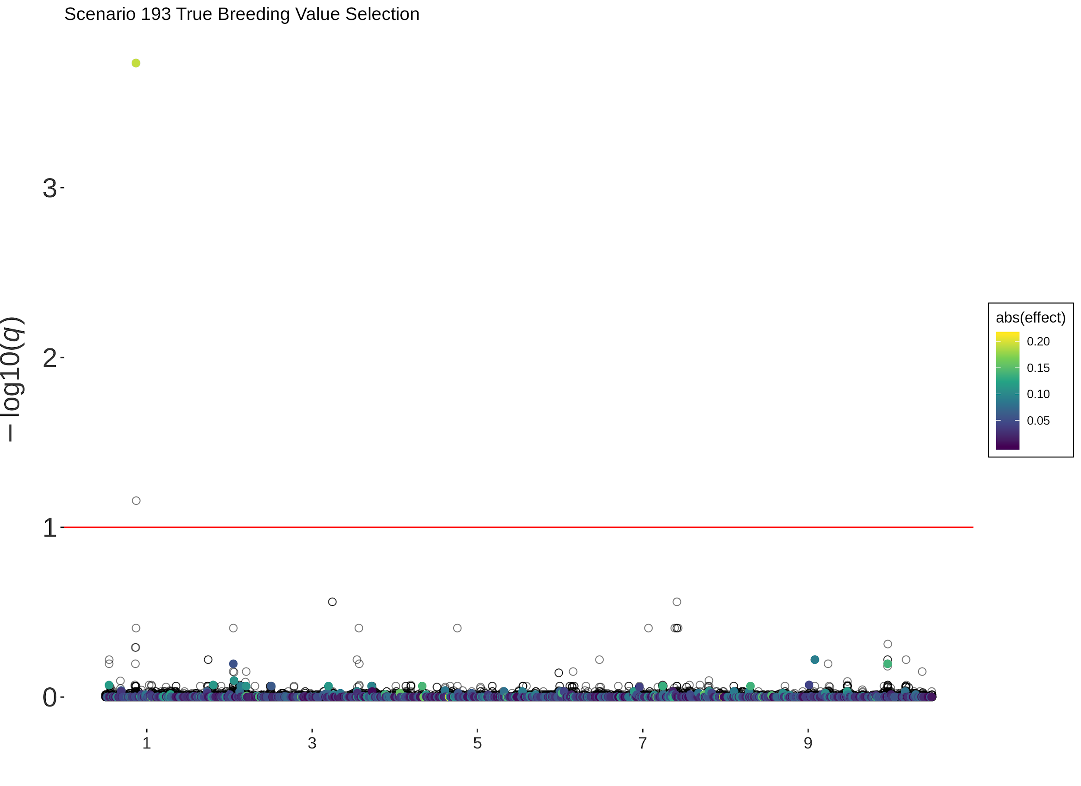
Increasing SNP Density
More coming… these take along time to run
Notes:
<number>

Slide 33
Next up...
Selection intensities
Uneven generation sampling
Stabilizing selection
EBV selection
Notes:
<number>

Slide 34
PhD Meeting
27th September 2019
Jana

Slide 35
AlphaPart: R-package for partitioning genetic trend
What is happening with the partition?
Reallocation of financial resources in a cattle breeding program

Slide 36
AlphaPart: what is happening with the fathers?
Pig breeding example
Founders
Founders
GN males
GN females
CROSS
Candidates GN
PN females
PN females
SELECT
GN males
GN females
CROSS
Candidates PN
SELECT
PN females

Slide 37
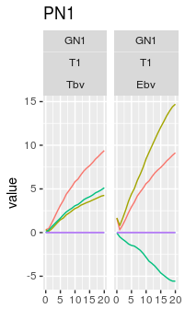
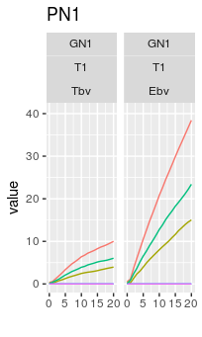
AlphaPart: what is happening with the fathers?
What is happening with the partition?
Intercept model:
Year + Tier:

Slide 38
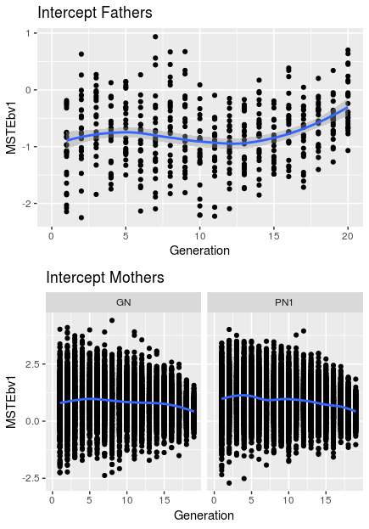
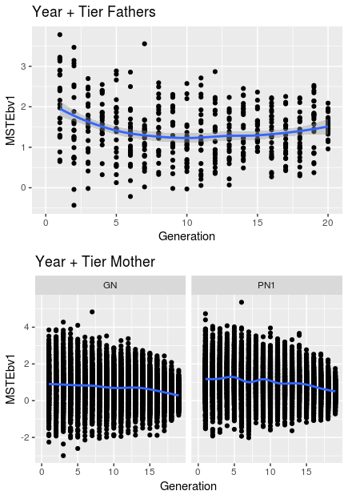
AlphaPart: what is happening with the fathers?
1) Check the MST values of the parents

Slide 39
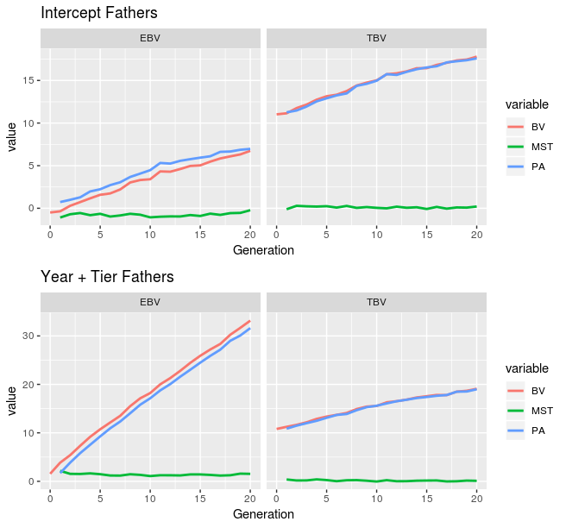
AlphaPart: what is happening with the fathers?
1) Check the MST values of the fathers
Negative MST for the fathers

Slide 40
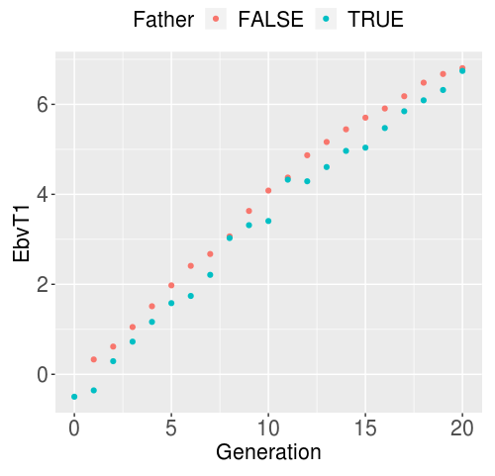
AlphaPart: what is happening with the fathers?
2) Check the EBVs of fathers / non-fathers
Are we not selecting the best males?
Remark: This are the EBVs from the last estimation!

Slide 41
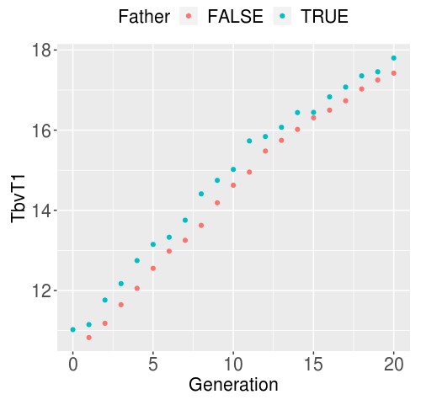
AlphaPart: what is happening with the fathers?
2) Check the EBVs of fathers / non-fathers
We are selecting the best males!

Slide 42
AlphaPart: what is happening with the fathers?
2) What is happening? Either …
We are not selecting the males with best EBVs → but the TBVs are OK?
The EBVs for fathers are dropping over generations (are worsening!)

Slide 43
AlphaPart: what is happening with the fathers?
2) What is happening?
We are not selecting the males with best EBVs →

Slide 44
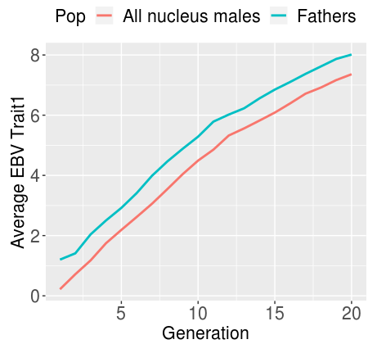
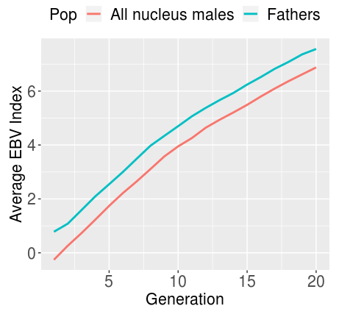
AlphaPart: what is happening with the fathers?
2) What is happening?
We are not selecting the males with best EBVs
EBVs at the time of selection
THIS IS OK!!!

Slide 45
AlphaPart: what is happening with the fathers?
2) What is happening?
The EBVs for fathers are dropping over generations (are worsening!) ???

Slide 46
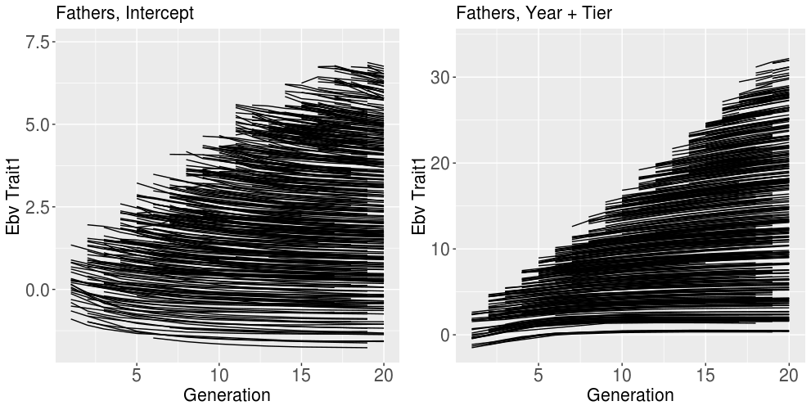
AlphaPart: what is happening with the fathers?
2) What is happening?
EBVs over time

Slide 47
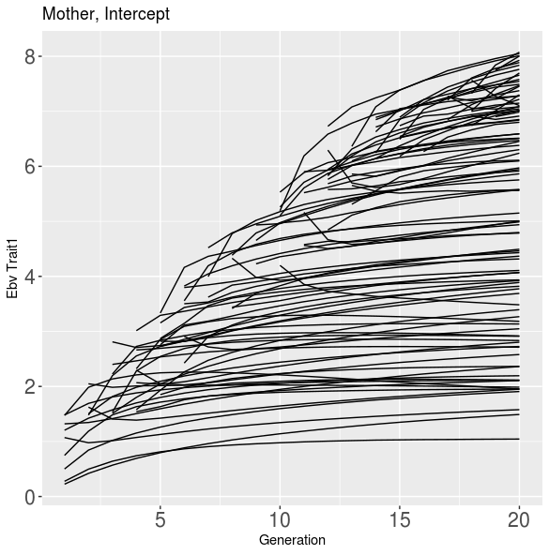
AlphaPart: what is happening with the fathers?
2) What is happening?
EBVs over time

Slide 48
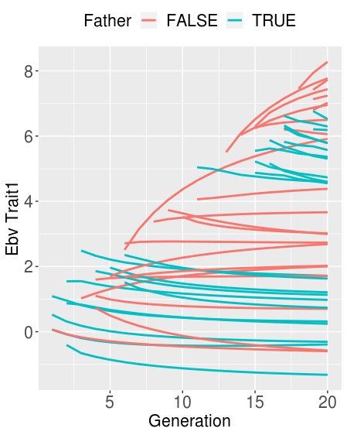
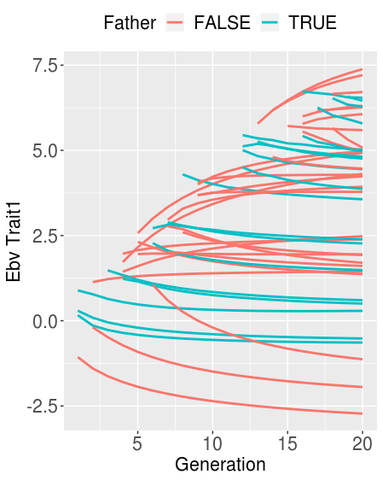
AlphaPart: what is happening with the fathers?
2) What is happening? INTERCEPT MODEL
Fathers’ EBVs → constantly dropping
Two samples from father/non-father population

Slide 49
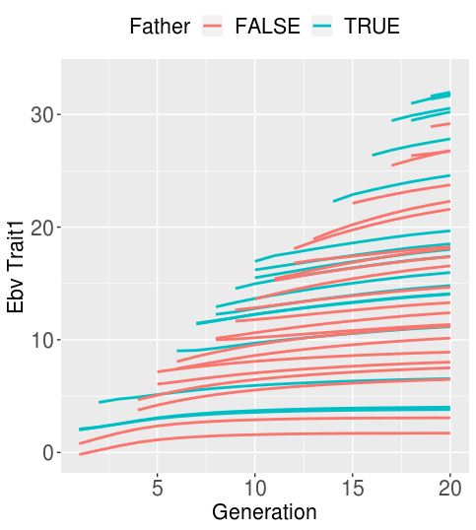
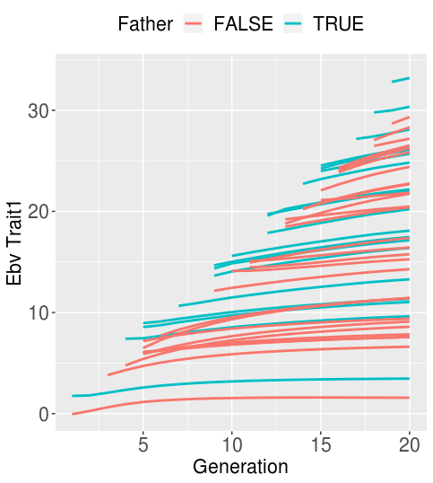
AlphaPart: what is happening with the fathers?
2) What is happening? YEAR + TIER MODEL
Two samples from father/non-father population

Slide 50
AlphaPart: what is happening with the fathers?
2) What is happening?
Model: EBV ~ Indiv + Generation
For fathers: coefficient for generation = -0.038
For non-fathers: ~ 0.003
Writing a paper:
Introduction, implementation (functions) written
Result and discussion

